Slide 1

Exploring the Semantic Kernel Agent Framework
Will Velida
Lead Software Engineer & Microsoft MVP
bsky.app/profile/willvelida.com
February 2025

Slide 2
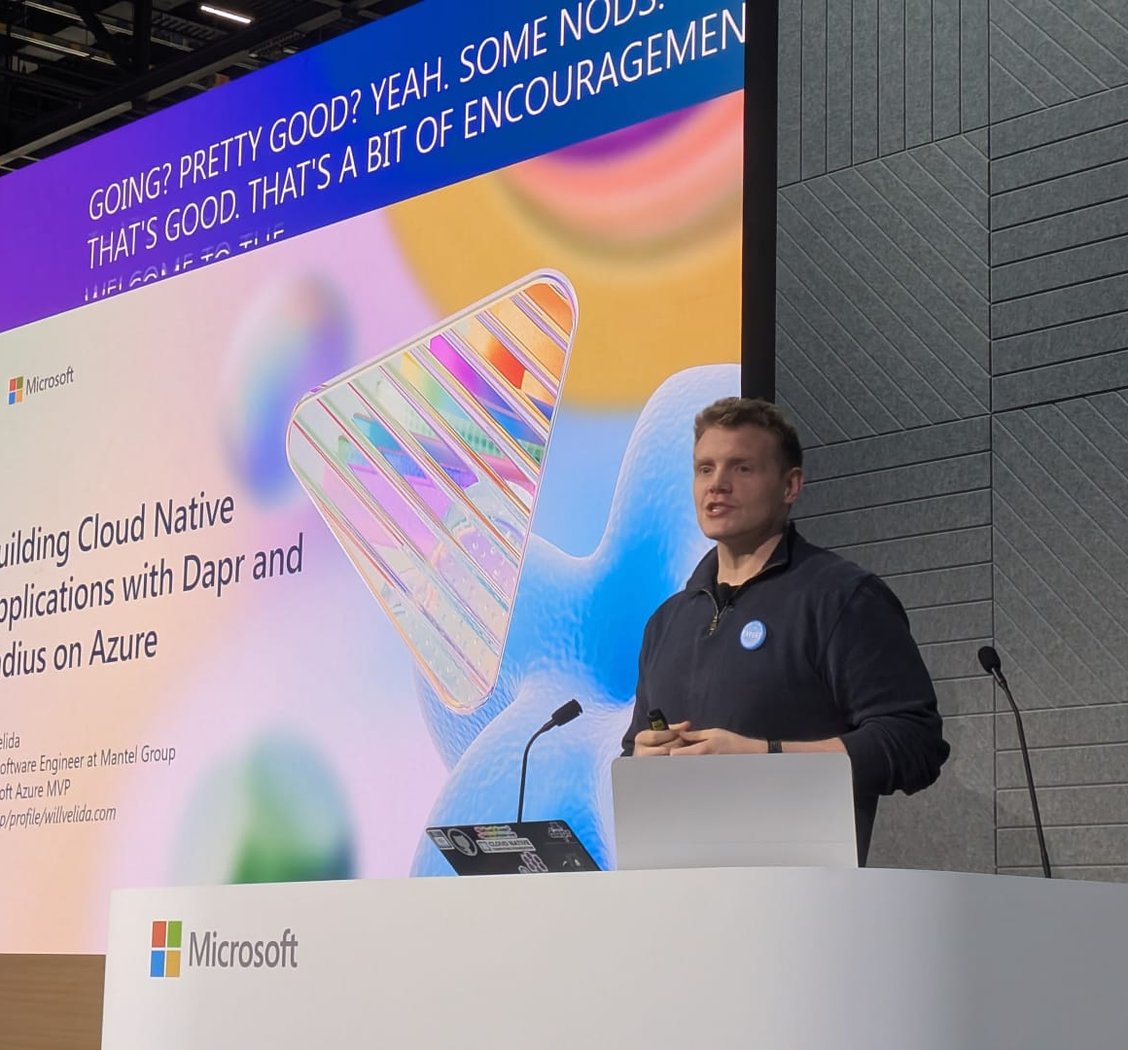
Hi, I’m Will
$ whoami
Lead Software Engineer @ Mantel Group, based in Melbourne.
Microsoft Azure MVP (Kubernetes and Open Source)
AI Sceptic and Enthusiast.

Slide 3
What we’re covering today
What are AI Agents?
Semantic Kernel Core Concepts
Semantic Kernel Agent Framework Goals and Architecture
Demos
Comparison with AutoGen and Azure AI Agent Service

Slide 4
What are AI Agents?
Large Language Model
Performs Action
Access to Tools
Knowledge
Notes:
AI Agents are software entities designed to perform tasks autonomously or semi-autonomously by receiving input, processing information, and taking actions to achieve specific goals.
Agents can send and receive messages, generating responses using a combination of models, tools, human inputs, or other customizable components.
Agents are designed to work collaboratively, enabling complex workflows by interacting with each other. The Agent Framework allows for the creation of both simple and sophisticated agents, enhancing modularity and ease of maintenance.

Slide 5
What problems do AI agents solve?
Modular components
Collaboration
Human-Agent Collaboration
Process Orchestration
Notes:
AI agents offer several advantages for app development, particularly by enabling us to create modular AI components that are able to collaborate to reduce manual intervention in complex tasks.
Some key benefits of AI Agents are:
Modular Components: Allows developers to define various types of agents for specific tasks (e.g., data scraping, API interaction, or natural language processing). This makes it easier to adapt the application as requirements evolve or new technologies emerge.
Collaboration: Multiple agents may "collaborate" on tasks. For example, one agent might handle data collection while another analyzes it and yet another uses the results to make decisions, creating a more sophisticated system with distributed intelligence.
Human-Agent Collaboration: Human-in-the-loop interactions allow agents to work alongside humans to augment decision-making processes. For instance, agents might prepare data analyses that humans can review and fine-tune, thus improving productivity.
Process Orchestration: Agents can coordinate different tasks across systems, tools, and APIs, helping to automate end-to-end processes like application deployments, cloud orchestration, or even creative processes like writing and design.

Slide 6



When should we use AI Agents?
Open-ended problems
Multi-step Processes
Improvement over time
Notes:
If we compare AI Agents to traditional AI applications where they are used for specific tasks (classification, prediction etc.), agents introduce more autonomy, flexibility and interactively into the development process.
Autonomy and Decision-Making: If your application requires entities that can make independent decisions and adapt to changing conditions (e.g., robotic systems, autonomous vehicles, smart environments), an agent framework is preferable.
Multi-Agent Collaboration: If your application involves complex systems that require multiple independent components to work together (e.g., supply chain management, distributed computing, or swarm robotics), agents provide built-in mechanisms for coordination and communication.
Interactive and Goal-Oriented: If your application involves goal-driven behavior (e.g., completing tasks autonomously or interacting with users to achieve specific objectives), agent-based frameworks are a better choice. Examples include virtual assistants, game AI, and task planners.

Slide 7
Agentic Design Principles
Space
Connecting, not collapsing
Accessible, yet occasionally invisible
Time
Past
Future
Core
Now
Embrace uncertainty, but establish trust
Notes:
There are many ways to think about building AI Agentic Systems. Given that ambiguity is a feature and not a bug in Generative AI design, it’s sometimes difficult for engineers to figure out where to even start.
In general, agents should:
Broaden and scale human capacities (brainstorming, problem-solving, automation, etc.)
Fill in knowledge gaps (get me up-to-speed on knowledge domains, translation, etc.)
Facilitate and support collaboration in the ways we as individuals prefer to work with others
Make us better versions of ourselves (e.g., life coach/task master, helping us learn emotional regulation and mindfulness skills, building resilience, etc.)
Agent (Space)
This is the environment in which the agent operates. These principles inform how we design agents for engaging in physical and digital worlds.
Connecting, not collapsing – help connect people to other people, events, and actionable knowledge to enable collaboration and connection.
Agents help connect events, knowledge, and people.
Agents bring people closer together. They are not designed to replace or belittle people.
Easily accessible yet occasionally invisible – agent largely operate in the background and only nudges us when it is relevant and appropriate.
Agent is easily discoverable and accessible for authorized users on any device or platform.
Agent supports multimodal inputs and outputs (sound, voice, text, etc.).
Agent can seamlessly transition between foreground and background; between proactive and reactive, depending on its sensing of user needs.
Agent may operate in invisible form, yet its background process path and collaboration with other Agents is transparent to and controllable by the user.
Agent (Time)
This is how the agent operates over time. These principles inform how we design agents interacting across the past, present, and future.
Past: Reflecting on history that includes both state and context.
Agent provides more relevant results based on analysis of richer historical data beyond only the event, people, or states.
Agent creates connections from past events and actively reflects on memory to engage with current situations.
Now: Nudging more than notifying.
Agent embodies a comprehensive approach to interacting with people. When an event happens, Agent goes beyond static notification or other static formality. Agent can simplify flows or dynamically generate cues to direct the user’s attention at the right moment.
Agent delivers information based on contextual environment, social and cultural changes and tailored to user intent.
Agent interaction can be gradual, evolving/growing in complexity to empower users over the long term.
Future: Adapting and evolving.
Agent adapts to various devices, platforms, and modalities.
Agent adapts to user behavior, accessibility needs, and is freely customizable.
Agent is shaped by and evolves through continuous user interaction.
Agent (Core)
These are the key elements in the core of an agent’s design.
Embrace uncertainty but establish trust.
A certain level of Agent uncertainty is expected. Uncertainty is a key element of agent design.
Trust and transparency are foundational layers of Agent design.
Humans are in control of when the Agent is on/off and Agent status is clearly visible at all times.

Slide 8
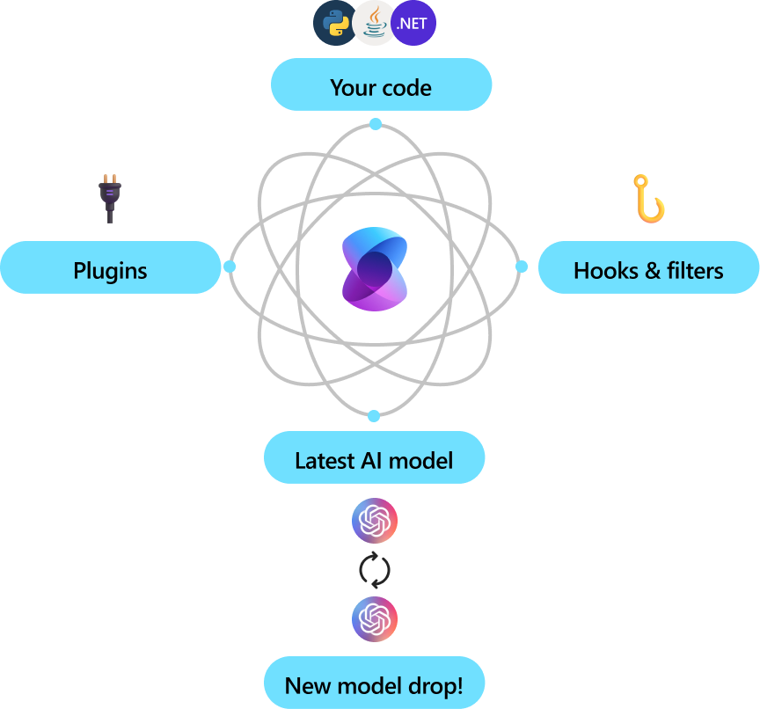
Semantic Kernel
Notes:
Semantic Kernel is a lightweight, open-source development kit that lets you easily build AI agents and integrate the latest AI models into your C#, Python, or Java codebase. It serves as an efficient middleware that enables rapid delivery of enterprise-grade solutions.
Semantic Kernel was designed to be future proof, easily connecting your code to the latest AI models evolving with the technology as it advances. When new models are released, you’ll simply swap them out without needing to rewrite your entire codebase.

Slide 9
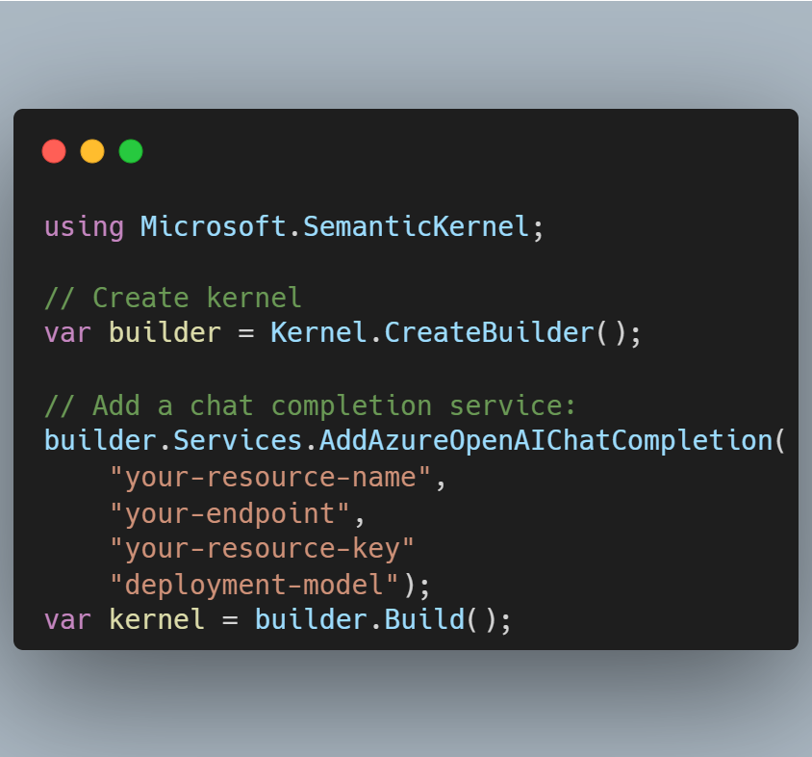
Semantic Kernel + Agent Framework
Semantic Kernel consists of two things – The Agent Framework and the Semantic Kernel itself
Connections – Interfacing with external AI services and data sources
Notes:
Semantic Kernel consists of two things, the Semantic Kernel Agent Framework and the Semantic Kernel itself.
Let's first talk about the Semantic Kernel. It has the following core concepts:
Connections: This is an interface with external AI services and data sources.
Here you have a simple example of how you can create a kernel and add a chat completion service. Semantic Kernel creates a connection to an external AI service, in this case, Azure OpenAI Chat Completion.

Slide 10
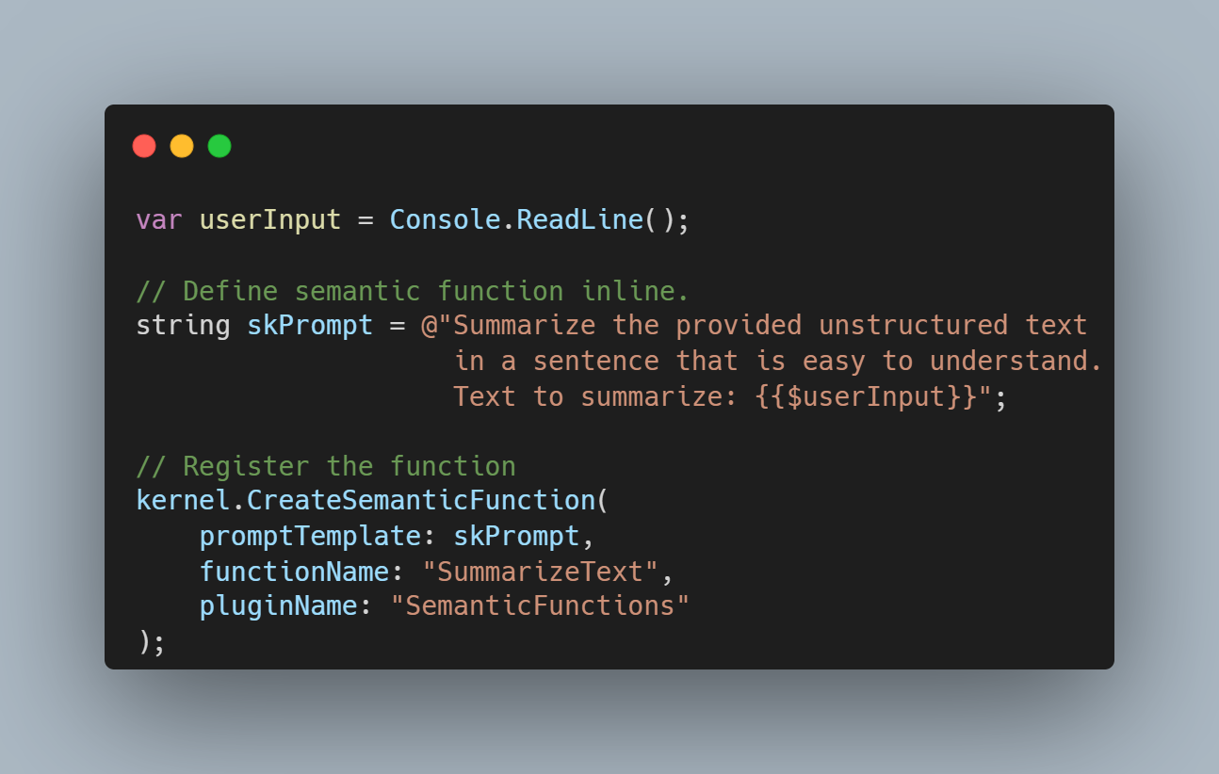
Semantic Kernel Plugins
Encapsulate functions that an app can use.
Can use out-of-the-box plugins or your own.
“Semantic Functions” are functions that you provide information to that helps Semantic Kernel figure out that it needs to be called.
Notes:
Plugins: Encapsulate functions that an application can use. There are both ready-made plugins and plugins you can create yourself. There's a concept here called "Semantic functions". What makes it semantic is that you provide it semantic information that helps Semantic Kernel figure out that this function needs to be called. Here's an example:
Here, you first have a template prompt skPrompt that leaves room for the user to input text, $userInput. Then you register the function SummarizeText with the plugin SemanticFunctions. Note the name of the function that helps Semantic Kernel understand what the function does and when it should be called

Slide 11
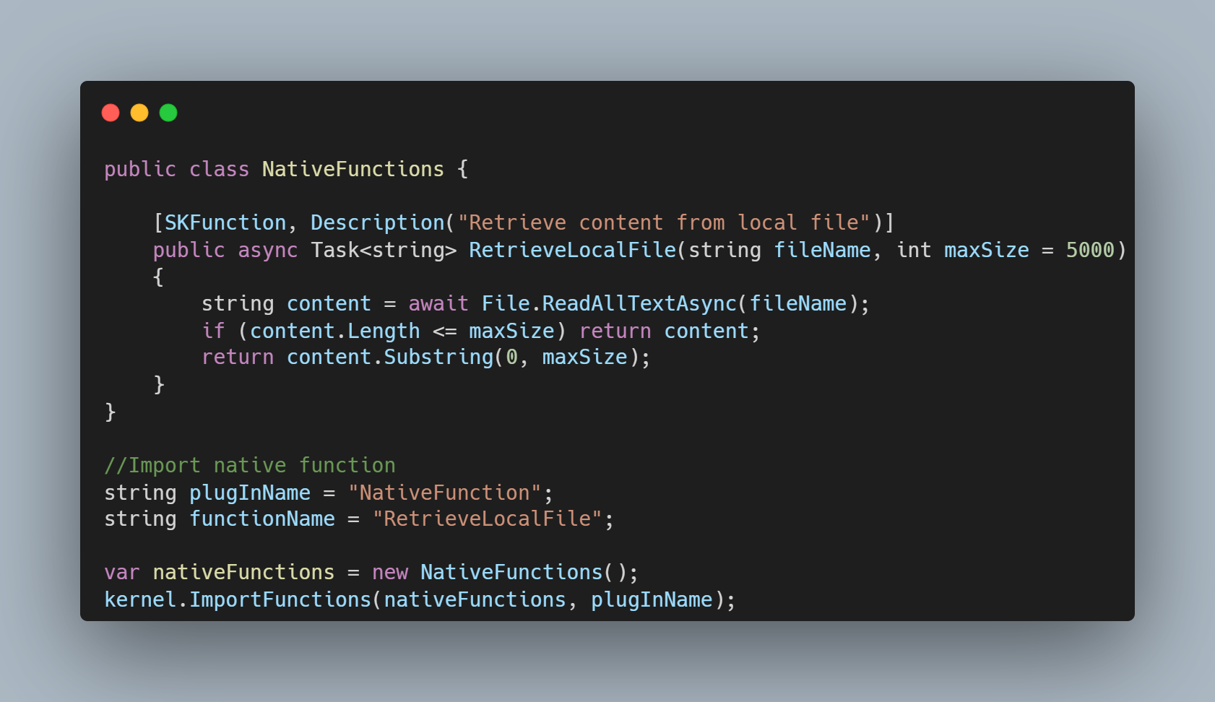
Native Function calling
Framework can call native functions to carry out tasks
Notes:
Native function: There's also native functions that the framework can call directly to carry out the task. Here's an example of such a function retrieving the content from a file:

Slide 12
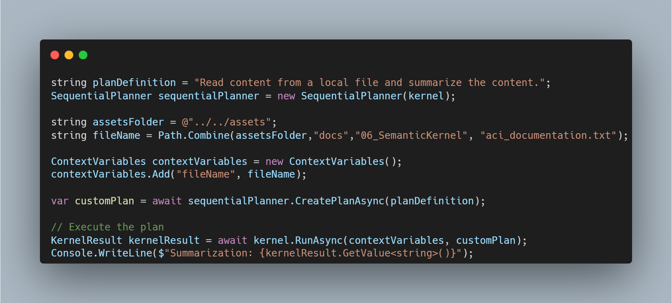
Planners
Executing plans and strategies based on user input
Notes:
Planner: The planner orchestrates execution plans and strategies based on user input. The idea is to express how things should be carried out which then surveys as an instruction for Semantic Kernel to follow. It then invoke the necessary functions to carry out the task. Here' an example of such a plan:
Note especially planDefinition which is a simple instruction for the planner to follow. The appropriate functions are then called based on this plan, in this case our semantic function SummarizeText and the native function RetrieveLocalFile.

Slide 13
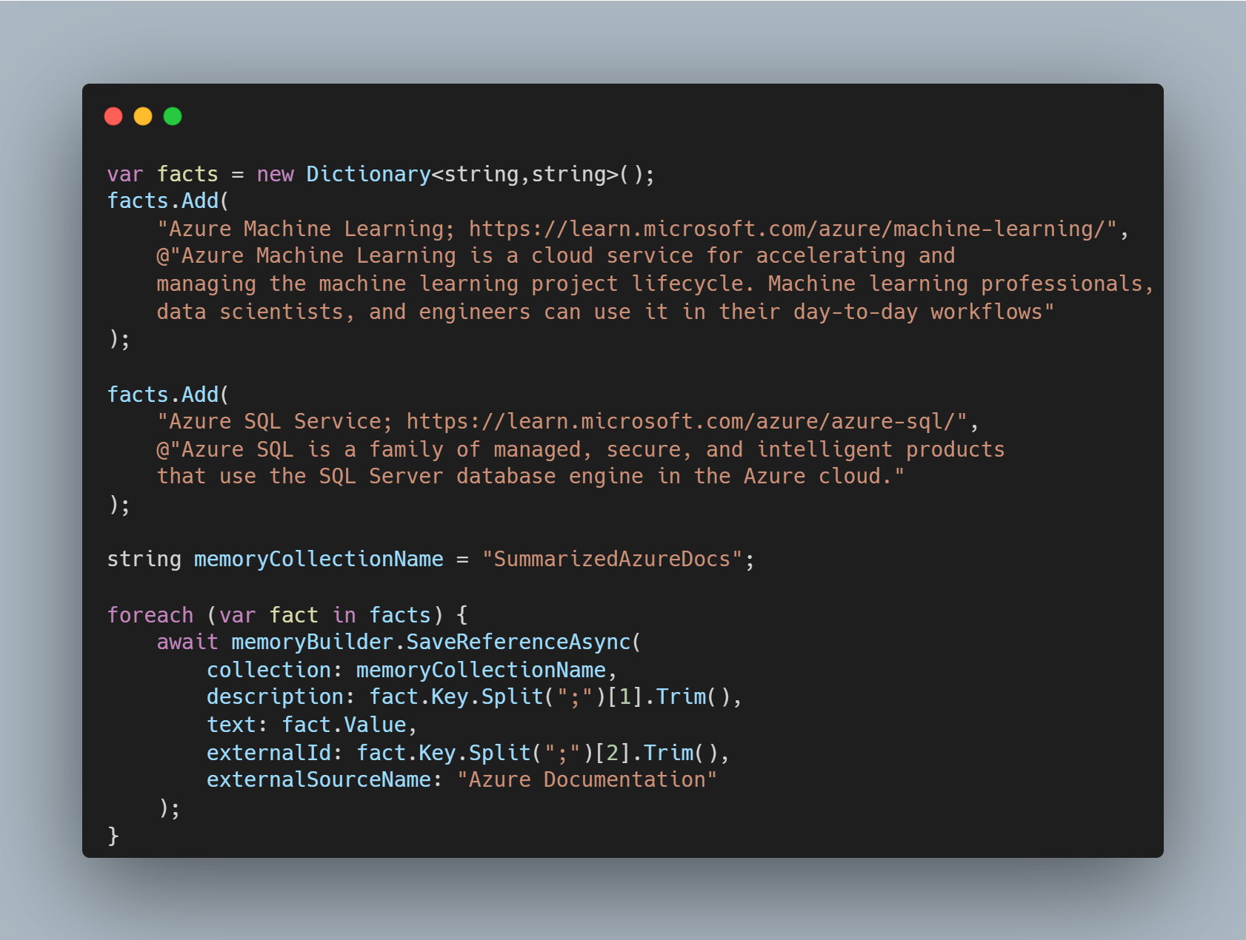
Memory
Abstracting and simplifying context for AI Apps
Notes:
Memory: Abstracts and simplifies context management for AI apps. The idea with memory is that this is something the LLM should know about. You can store this information in a vector store which ends up being an in-memory database or a vector database or similar. Here's an example of a very simplified scenario where facts are added to the memory:
These facts are then stored in the memory collection SummarizedAzureDocs. This is a very simplified example, but you can see how you can store information in the memory for the LLM to use.

Slide 14
Goals of the Agent Framework
Semantic Kernel provides core foundation for implementing agents.
Multiple agents can collaborate within a single conversation.
Agents can engage in multiple concurrent conversations.
Different types of agents can participate in same conversation.
Notes:
The Semantic Kernel framework serves as the core foundation for implementing agent functionalities.
Multiple agents can collaborate within a single conversation, while integrating human input.
An agent can engage in and manage multiple concurrent conversations simultaneously.
Different types of agents can participate in the same conversation, each contributing their unique capabilities.

Slide 15
Agent Framework Architecture
Agent
Agent Channel
Agent Messages
Agent Chat
Notes:
The Agent class is an abstract class that serves as the core abstraction for all types of agents, which can be expanded to create more specialized agents. There’s a subclass Kernel Agent which establishes a direct association with a Kernel object to enable specific agent implementations.
Agents can be invoked directly, or orchestrated within an Agent Chat, where multiple agents may collaborate or interact dynamically with user inputs (which is great for agents to adapt to various conversational scenarios or task-driven scenarios)
Multiple agents of various types can participate in a Agent Chant within the Agent Channel class. This class really only concerns us when creating custom agents.
Finally, agent messaging is built on the core content types of the Semantic Kernel for communication. This helps is to integrate agent capabilities into apps without having to rewrite the whole application.

Slide 16
Demo time!

Slide 17
Difference between other Frameworks
Framework | Focus
AutoGen | Focuses on event-driven, distributed agentic applications, enabling multiple LLMs and SLMs, tools, and advanced multi-agent design patterns
Semantic Kernel | Focus on understanding and generating human-like text content by capturing deeper semantic meanings. Designed to automate complex workflows and initiate tasks based on project goals
Azure AI Agent Service | Provides more flexible models, offering stronger enterprise security mechanisms and data storage methods.

Slide 18





Thanks for listening
willvelida.com
github.com/willvelida
twitter.com/willvelida
linkedin.com/in/willvelida
youtube.com/@willvelida

